Slide 1
Machine Learning Practice
Deep NNs

Slide 2
References
Andrew Ng’s ML class
https://class.coursera.org/ml-003/lecture
http://www.holehouse.org/mlclass/ (note)
Convolutional Neural Networks for Visual Recognition.
http://cs231n.github.io/
Tensorflow
https://www.tensorflow.org
https://github.com/aymericdamien/TensorFlow-Examples
모두의 머신러닝
Wikipedia
Neural Network and Deep Learning, Michael Nielsen,
http://neuralnetworksanddepplearning.com

Slide 3
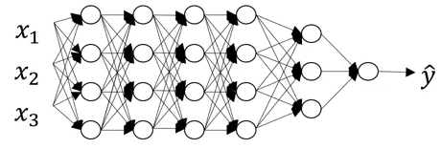
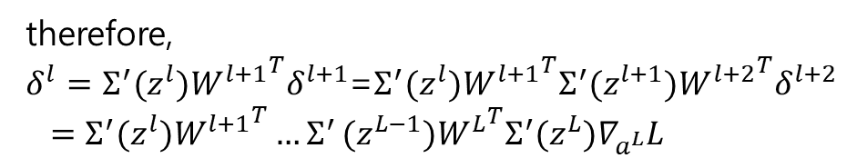
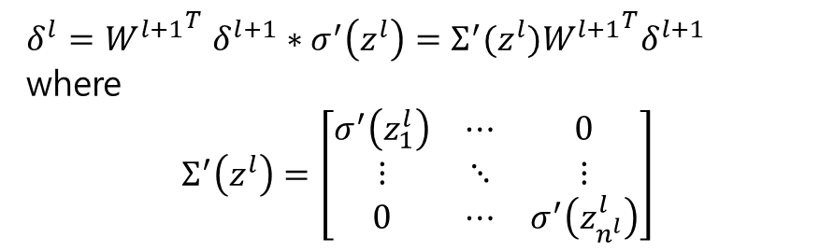


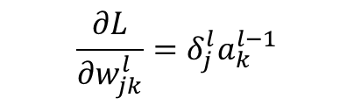

Deep NNs (vs. shallow NNs)
More hidden layers
$δ^{l}{{=W}^{l+1}}^{T}δ^{l+1}∗σ^{′}\left(z^{l}\right)=Σ^{′}(z^{l}){W^{l+1}}^{T}δ^{l+1}$
where
$$Σ^{′}\left(z^{l}\right)=\left[\begin{matrix}σ^{′}\left(z_{1}^{l}\right) & ⋯ & 0 \\ ⋮ & ⋱ & ⋮ \\ 0 & ⋯ & σ^{′}\left(z_{n^{l}}^{l}\right)\end{matrix}\right]$$
$$δ^{L}=∇_{a^{L}}L∗σ′(z^{L})$$
therefore,
$δ^{l}=Σ^{′}(z^{l}){W^{l+1}}^{T}δ^{l+1}$=$Σ^{′}(z^{l}){W^{l+1}}^{T}Σ^{′}(z^{l+1}){W^{l+2}}^{T}δ^{l+2}$
$=Σ^{′}(z^{l}){W^{l+1}}^{T}{…Σ}^{′}(z^{L−1}){W^{L}}^{T}Σ^{′}(z^{L})∇_{a^{L}}L$
$$δ^{l−1}{{=W}^{l}}^{T}δ^{l}∗σ′(z^{l−1})$$
$$\frac{∂L}{∂w_{jk}^{l}}=δ_{j}^{l}a_{k}^{l−1}$$
$$\frac{∂L}{∂b_{j}^{l}}=δ_{j}^{l}$$

Slide 4

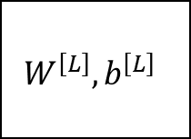


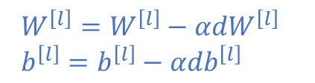



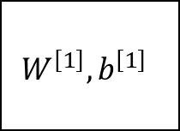






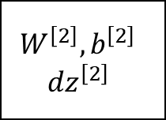

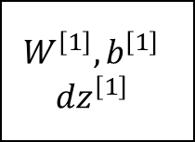
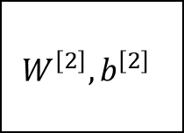
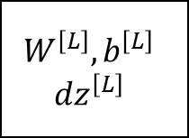
Forward and backward functions
Layer 1
Layer 2
Layer 3
Layer L
$$W^{\left[1\right]},b^{\left[1\right]}$$
$$a^{\left[1\right]}$$
$$W^{\left[2\right]},b^{\left[2\right]}$$
$$a^{\left[2\right]}$$
$$W^{\left[L\right]},b^{\left[L\right]}$$
$$a^{\left[L\right]}=\hat{y}$$
$$a^{\left[0\right]}$$
cache $z^{\left[1\right]}$
$$z^{\left[L\right]}$$
$$W^{\left[1\right]},b^{\left[1\right]}$$
$${dz}^{\left[1\right]}$$
$${da}^{\left[l\right]}$$
$$W^{\left[2\right]},b^{\left[2\right]}$$
$${dz}^{\left[2\right]}$$
$${da}^{\left[2\right]}$$
$$W^{\left[L\right]},b^{\left[L\right]}$$
$${dz}^{\left[L\right]}$$
$${da}^{\left[L\right]}$$
$${dW}^{\left[1\right]},db^{\left[1\right]}$$
$${dW}^{\left[2\right]},db^{\left[2\right]}$$
$${dW}^{\left[3\right]},db^{\left[3\right]}$$
$${dW}^{\left[L\right]},db^{\left[L\right]}$$
$W^{\left[l\right]}=W^{\left[l\right]}−αdW^{\left[l\right]}$
$b^{\left[l\right]}=b^{\left[l\right]}−αdb^{\left[l\right]}$

Slide 5
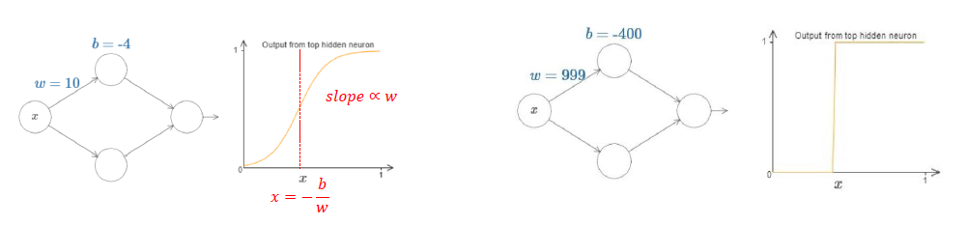
University with one input and one output
Two assumptions
This doesn't mean that a network can be used to exactly compute any function
The class of functions which can be approximated in the way described are the continuous functions
http://neuralnetworksanddepplearning.com

Slide 6
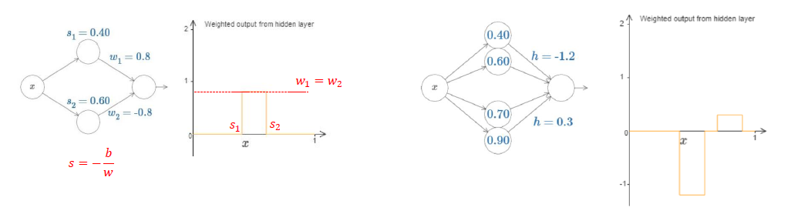
University with one input and one output
Assume that the output neuron has the identity activation function
http://neuralnetworksanddepplearning.com

Slide 7
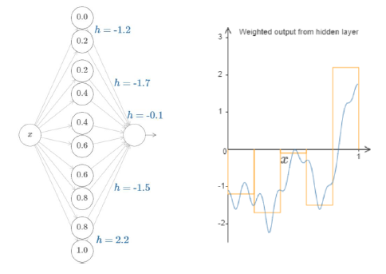
University with one input and one output
The answer to the question whether any particular function is approximately computable using a neural network is “yes”.
http://neuralnetworksanddepplearning.com

Slide 8
Why deep networks?
Informally: There are functions you can compute with a “small” L-layer deep neural network that shallower networks require exponentially more hidden units to compute.
e.g., x1 XOR x2 XOR x3 XOR … xn
x1
x1
XOR
x2
x2
XOR
x3
x3
XOR
x4
XOR
x4
y
x5
x5
XOR
XOR
Depth of NN : O(logN)
→ N-1 Nodes
To consider All possible combination, O(2^n) nodes are required

Slide 9
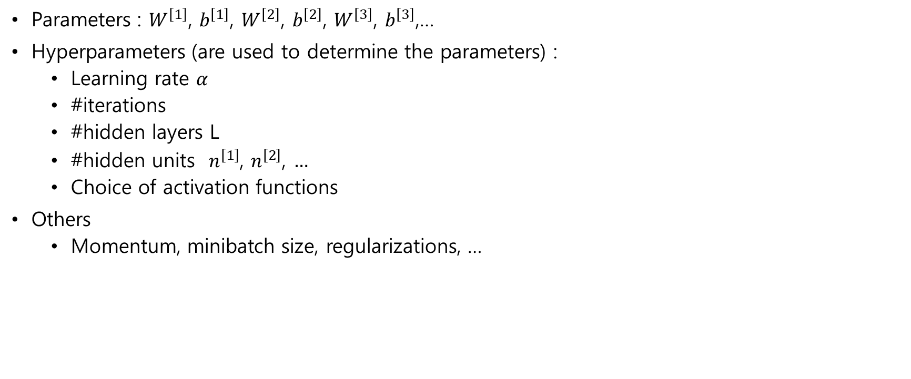
Hyperparameters
Parameters : $W^{\left[1\right]}$, $b^{\left[1\right]}$, $W^{\left[2\right]}$, $b^{\left[2\right]}$, $W^{\left[3\right]}$, $b^{\left[3\right]}$,…
Hyperparameters (are used to determine the parameters) :
Learning rate $α$
#iterations
#hidden layers L
#hidden units $n^{\left[1\right]}$, $n^{\left[2\right]}$, $…$
Choice of activation functions
Others
Momentum, minibatch size, regularizations, …

